Slide 1
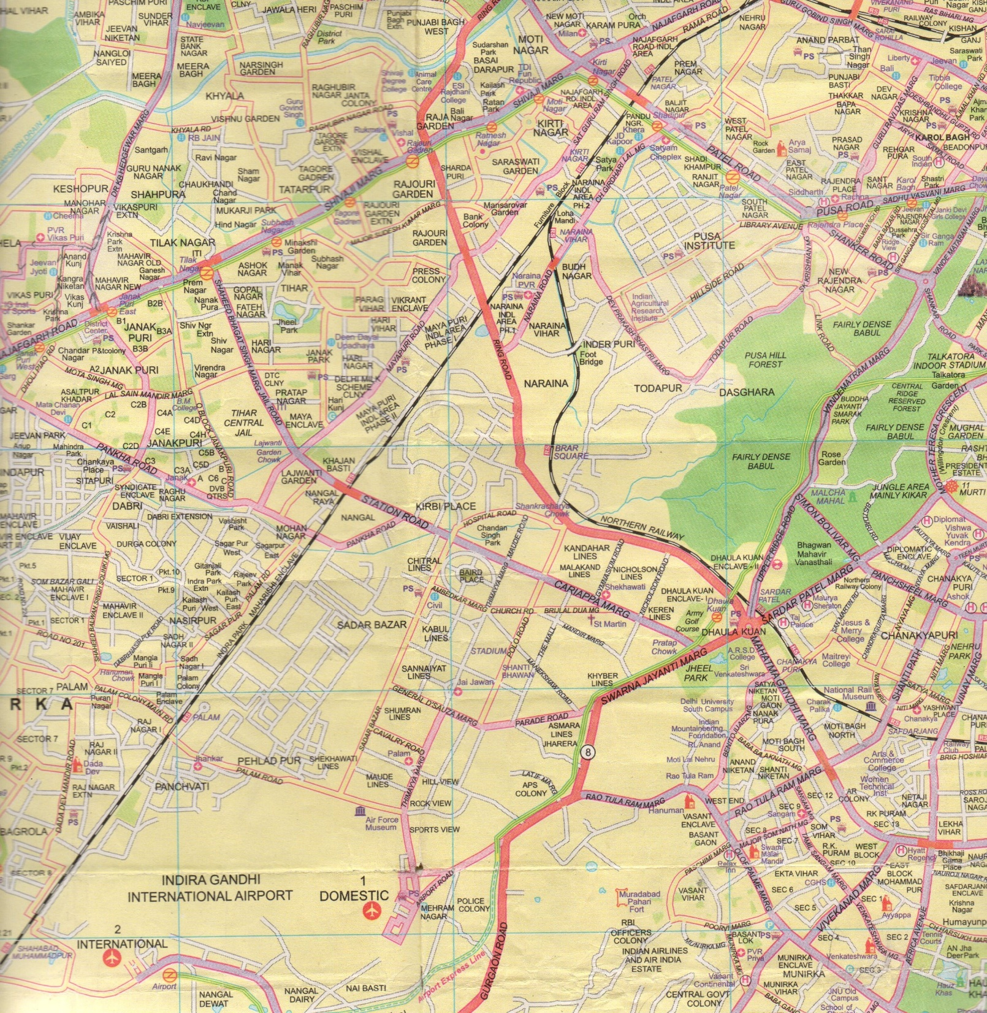
Route No. 16
END
TIS

Slide 2
Area | Landmark | Morning Timings | Afternoon Timings
Inderpuri | Shiv Bhandar | 6:40 am | 3:15 pm
Inderpuri | EA Block (Gate) | 6:45 am | -
Inderpuri | Kadda Park | 6:50 am | -
I Block | Loha Mandi | 7:00 am | 3:08 pm
G Block | PNB Bank | 7:02 am | 3:07 pm
F & G Block | Park next to Santan Dharam Mandir | 7:04 am | 3:05 pm
H-Block | Main gate | 7:05 am | 3:03 pm
Gurudwara | Gurudwara T-Point | 7:06 am | 3:00 pm
A Block | Polka Bakery | 7:10 am | 2:50 pm

